Slide 1
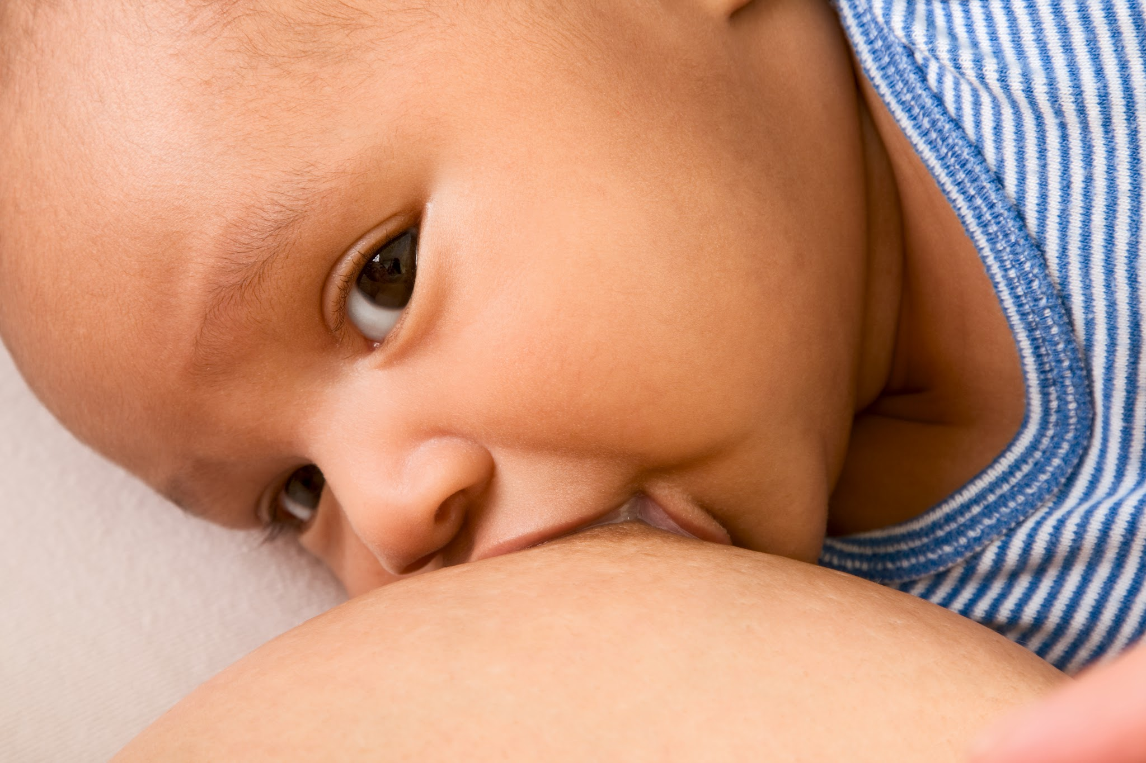
Spanish for Lactation Consultants
Useful phrases for our class

Slide 2
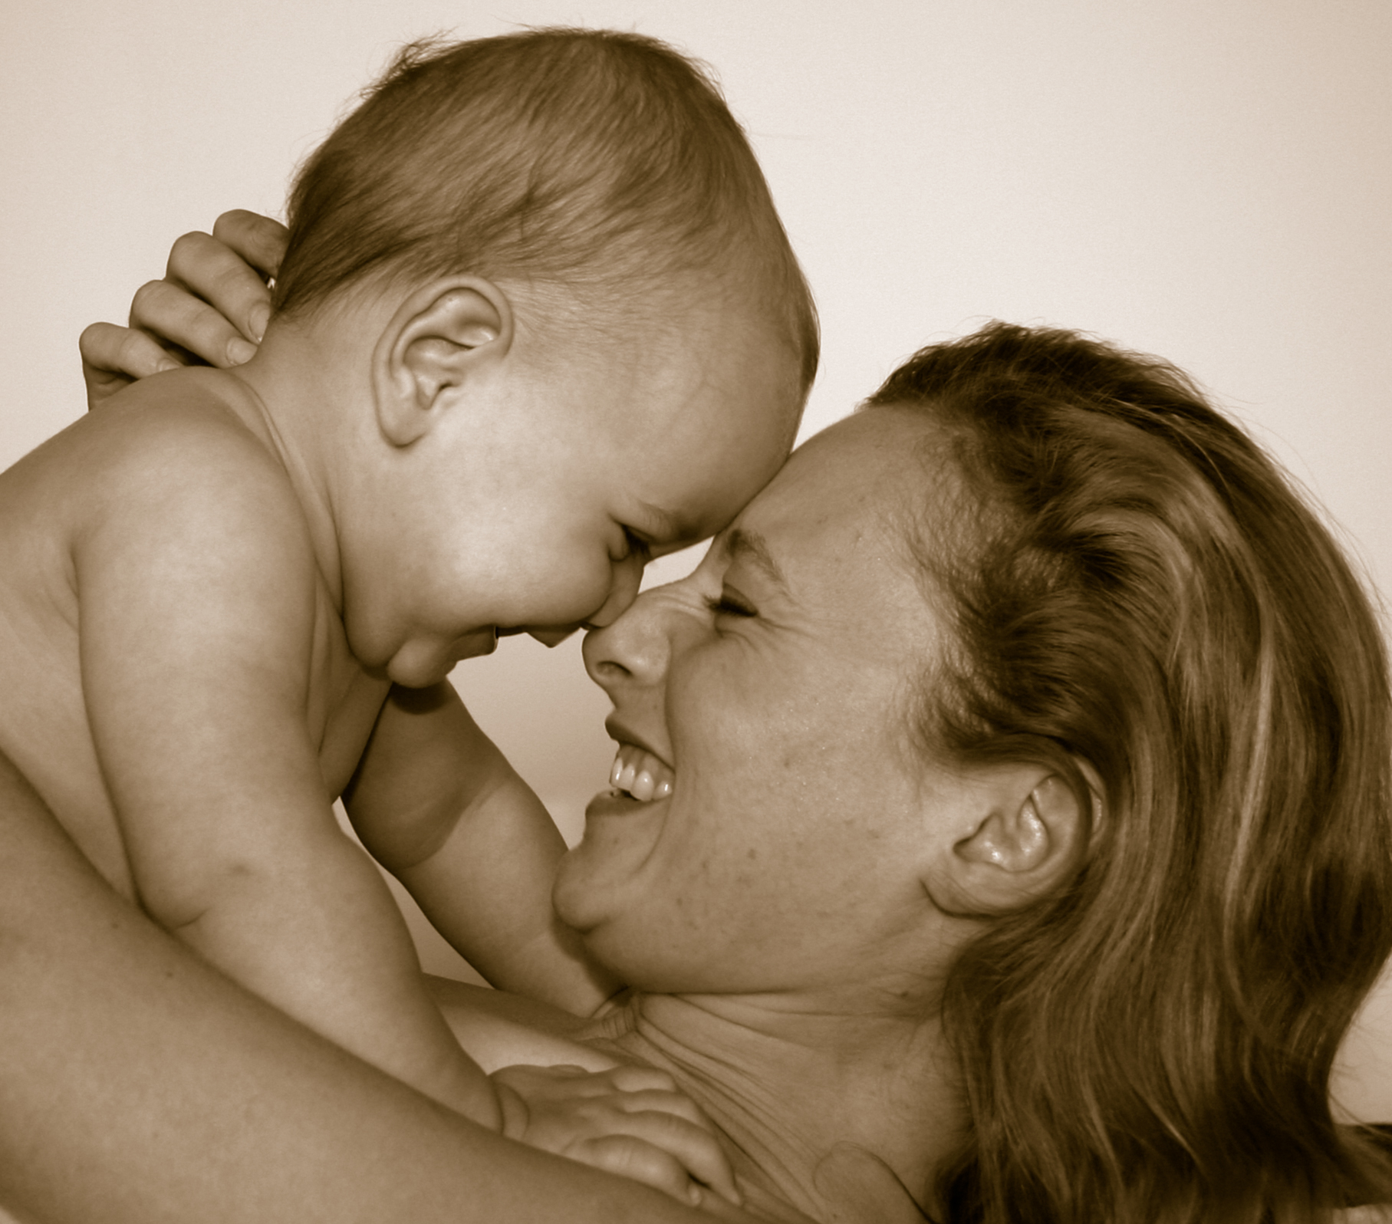
Let's learn some phrases to help us communicate in Spanish in the class!
While you may speak in English, we can avoid a lot of English in the class just by learning how to say a few key phrases.

Slide 3
Repita, por favor!
¿Cómo se dice...? How do you say...?
¿Cómo se escribe...? How do you write...?
Repita, por favor. Repeat, please.
¿Qué significa...? What does....mean?
(No) comprendo. I (don't) understand.
Tengo una pregunta. I have a question.
Escríbalo, por favor. Write it, please.
(No) lo sé. I don't know.

Slide 4
Learning Whole Phrases
I recommend that you learn a whole phrase sometimes. Memorize it.
You don't have to build every sentence from scratch, and things that you repeat often will be the first things you really learn!

Slide 5
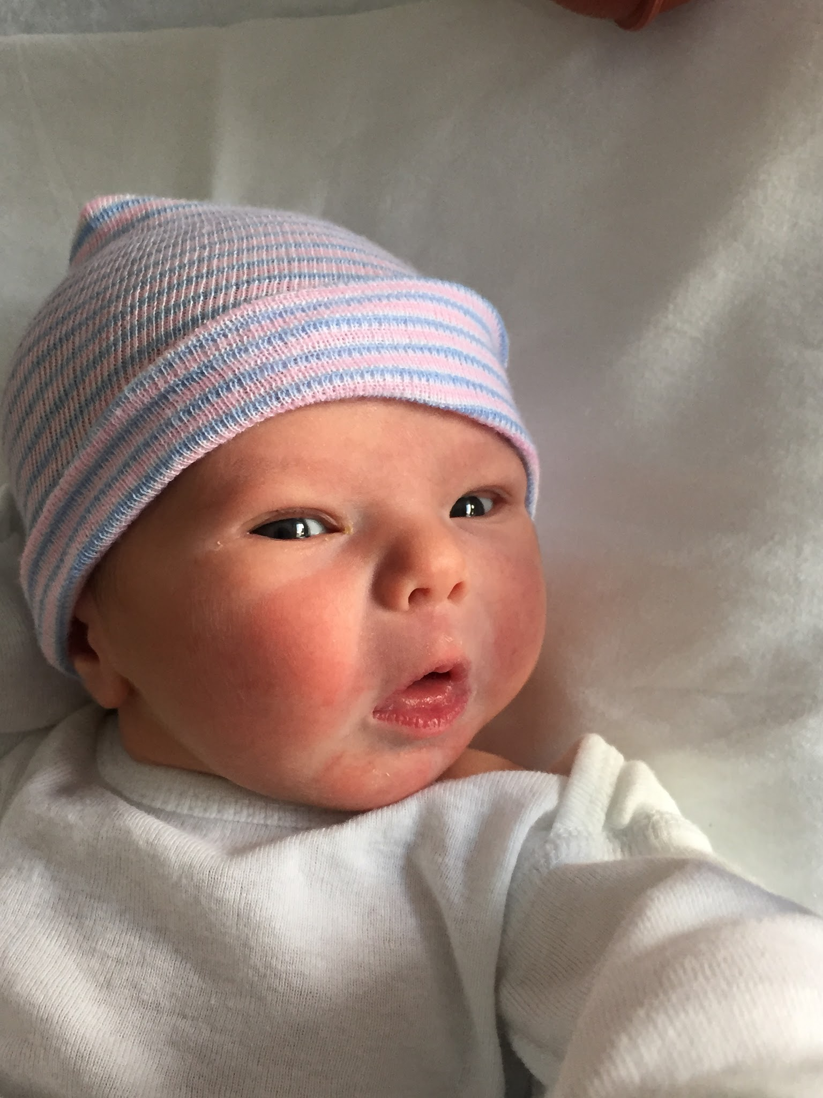
You can make a difference with your Spanish
Achieve Confidence Through Repetition.
A single, well-spoken phrase can make the difference between a healthy baby and a sick one.

Slide 6
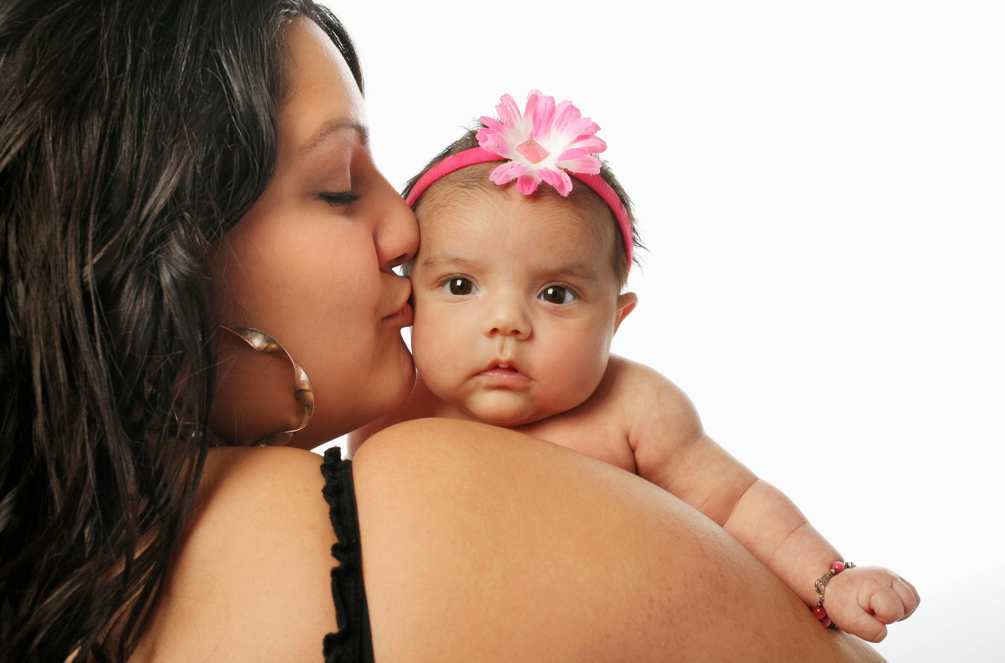
REMEMBER: Práctica hace al maestro!
PRACTICE MAKES PERFECT!
See you in class.

